Slide 1

TicTacToe Live
CS373 Final, Jim Spisto, Jared Moore

Slide 2
Why did we choose this project?
It seemed interesting
To learn more about:
React Native
Websockets
Node js / Express
MongoDB

Slide 3
What does it do?
Two players can play tic tac toe against each other in real time, on mobile, or in a browser
Players can create an account, login and start a game
A player is given a game code, which they share with a friend
When the second player enters the game code, the game begins
The game keeps track of games won, and games played

Slide 4
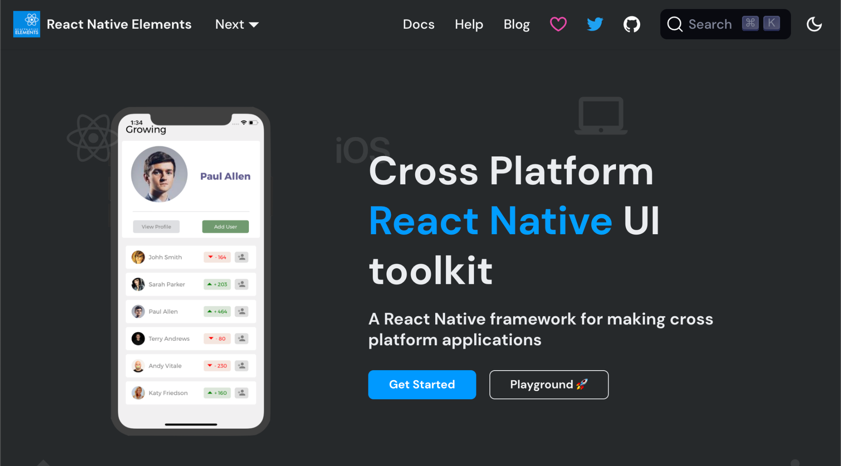
Tools
VSCode
React Native Expo build-tools for Android
Android Studio emulator for app development
Docker for development and deployment
React Native Elements UI library for components

Slide 5

Frontend
The frontend is written in React Native
React Native uses the React Framework to create UI for web Android, IOS, web and more
Creates native apps as if they were developed within Android Studio

Slide 6
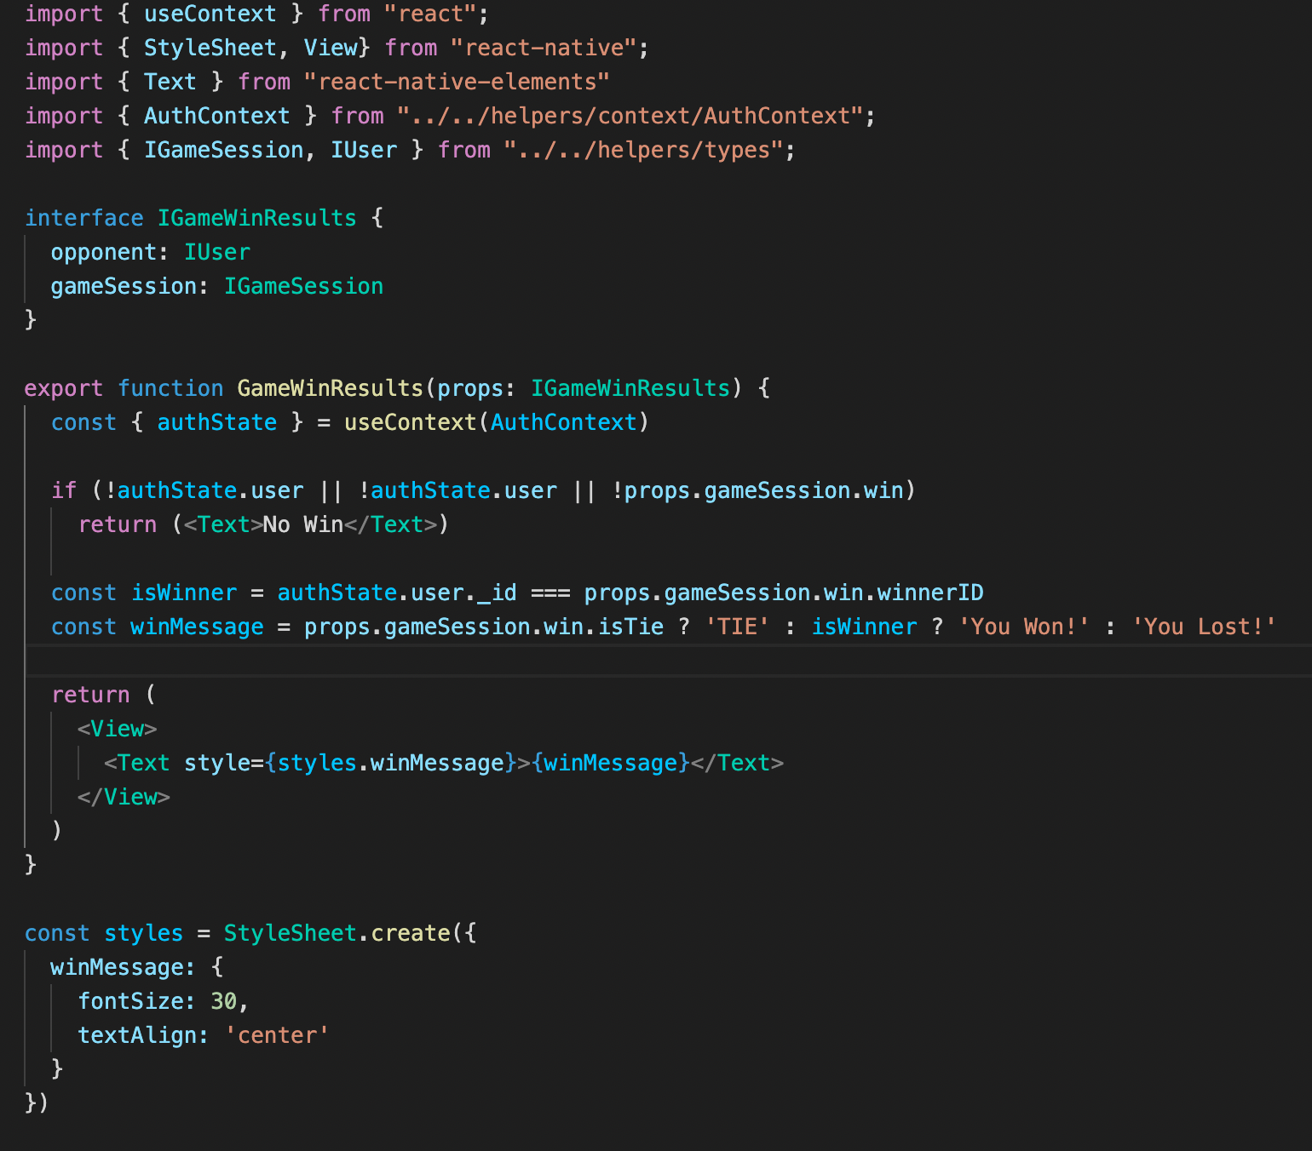
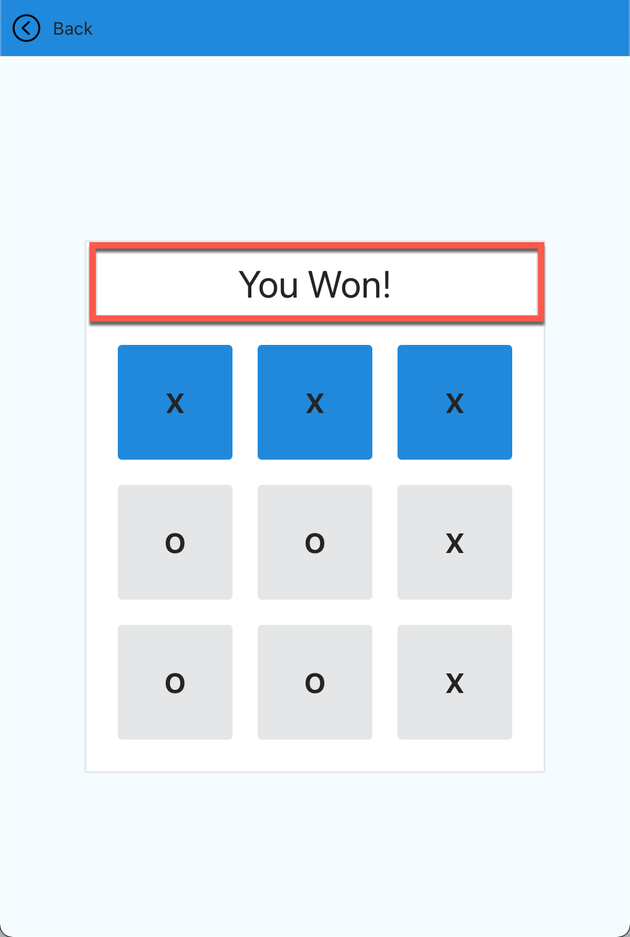
Example React Component

Slide 7
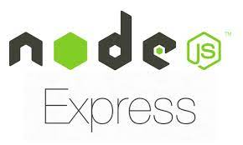
Backend
Our backend uses the express framework
Express is a backend framework for creating web applications and APIs with Node
The backend REST API is used for logging players in, but not for the gameplay experience

Slide 8

Database
Our database is MongoDB
MongoDB is a NOSQL database
Our database keeps track of user information, including wins and losses
Our database cluster is hosted on MongoDB Atlas free-tier using Microsoft Azure

Slide 9

Socket Server
Socket.io is the library that runs our websocket server
Simplifies writing and managing socket communication
React Native library allows for socket.io integration
Establishes real-time communication between server and client via http handshake

Slide 10
Live Multiplayer
Live multiplayer is enabled via web sockets
A Websocket creates a two way interactive connection
With a Websocket API a user can send and receive messages to a server without having to wait for a response compared to a REST API
A popular example of this feature in day to day life is instant messaging apps where you can see when someone is typing

Slide 11
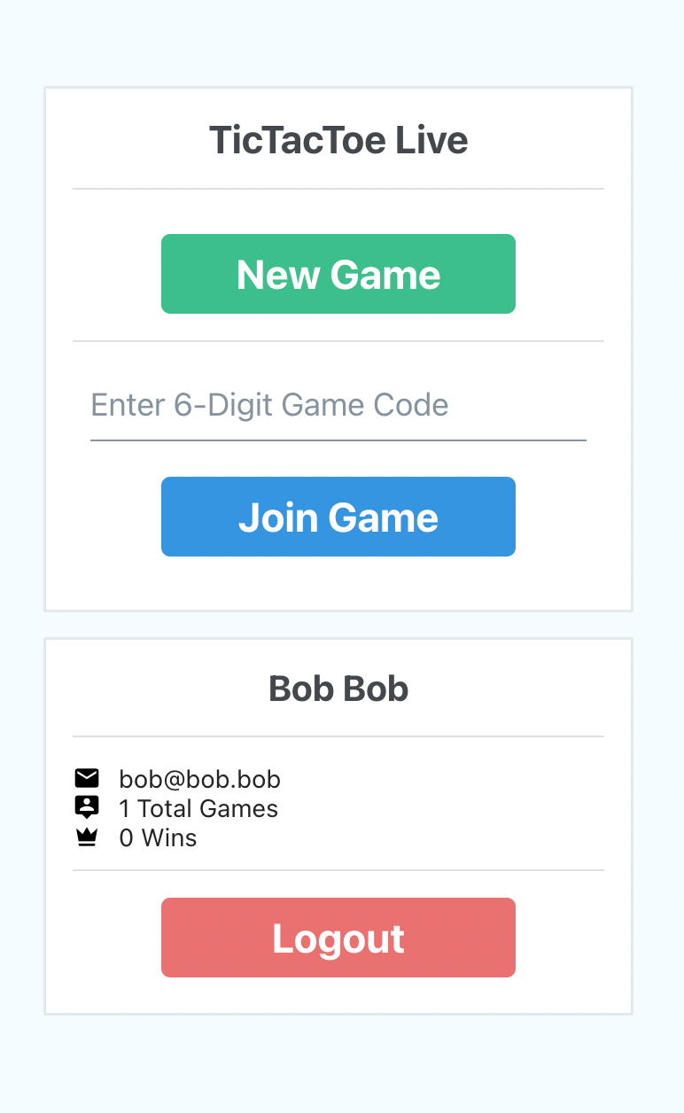
What does it do?
Two players can play tic tac toe against each other in real time, on mobile, or in a browser
Players can create an account, login and start a game
A player is given a game code, which they share with a friend
When the second player enters the game code, the game begins
The game keeps track of games won, and games played

Slide 12
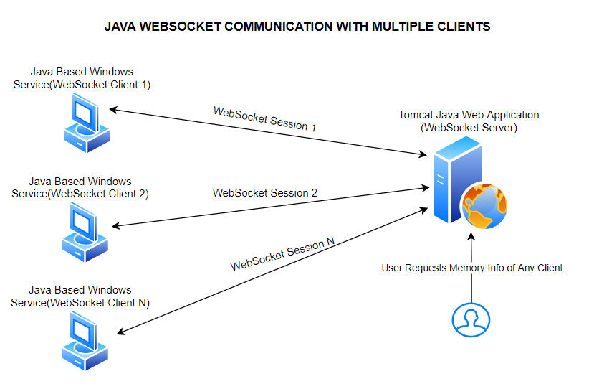
HTTP vs Websocket
HTTP requests GET, POST, ect are Stateless
Every HTTP request opens and closes a new TCP connection
WebSockets are stateful
The TCP connection stays alive until either party ends the connection
Websockets have datastreams
This makes websockets the superior choice for gaming and chat applications
https://www.thedeveloperfriend.com/wp-content/uploads/2020/07/java_websocket_1.png

Slide 13
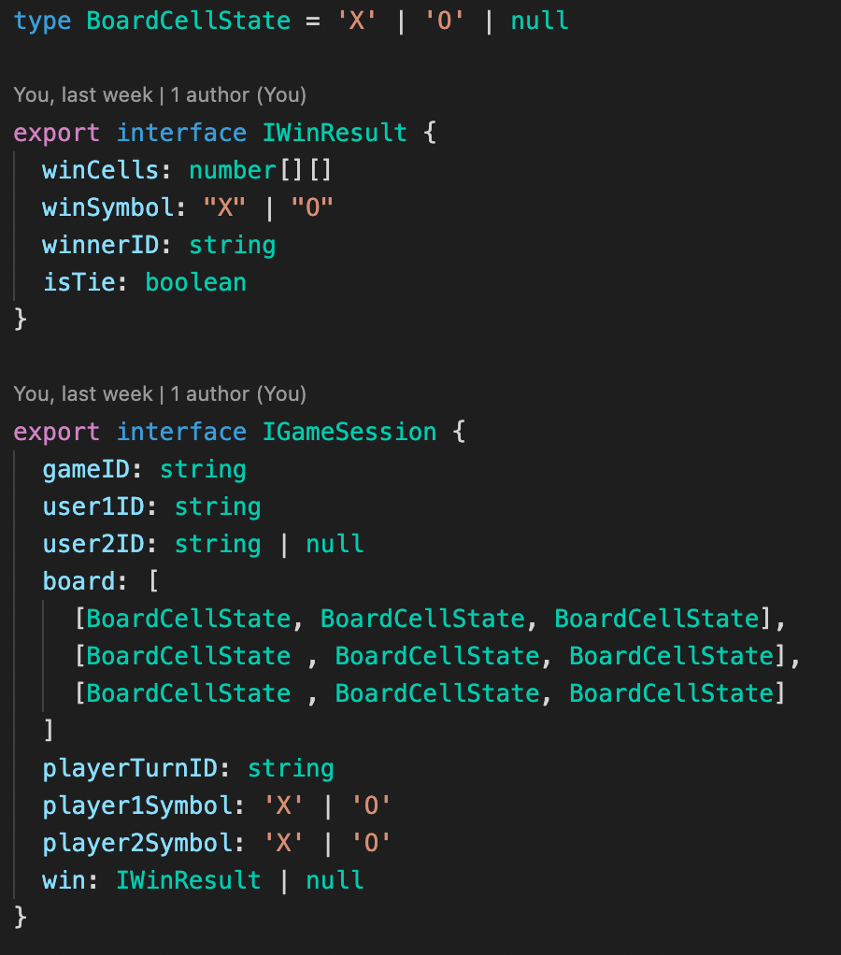
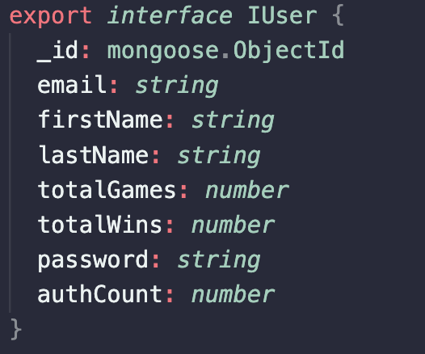
What is the format of the Data
Socket Data Object
MongoDB User Object

Slide 14
Live Demo
Try it yourself at bit.ly/tictactoe-live

Slide 15
What did we learn?
What are websockets and how they differ from Rest API
Which websocket clients are the best for Android Platform
Generating Android and Cross Platform apps from single codebase
Hosting a websocket and http server on Heroku Development Cloud Platform
Building .apk Android App via Expo Build Services

Slide 16
What would we do differently
Create an option where users don’t have to sign up
Hosting on AWS vs Heroku
Allow users to join a random user searching for a game
Improve the initial http websocket handshake for less-buggy game joining experience
Validate websocket data is communicated over https for secure gameplay

Slide 17
Other things to add to the project:
Adding animations when a user clicks a box
Adding animations to the homepage
Play again button
Allow user to change password, name, email
Allow user to delete account
Allow player to play against Tic Tac Toe algorithm

Slide 18
Citations:
https://reactnativeelements.com/docs
https://socket.io/docs/v4/
https://reactnative.dev/docs/getting-started
https://docs.expo.dev/
https://docs.expo.dev/build/introduction/
https://www.typescriptlang.org/docs/
https://mongoosejs.com/docs/
https://nodejs.org/dist/latest-v16.x/docs/api/

